Slide 1



-: Mobile Price Prediction :-
ISTE Approved
Free One WEEK Online WORKSHOP on
"Joy of Programming using Python"
Dates: (April 25-May 1, 2020)
Organized by
Computer Engineering Department, C.K.Pithawala College of Engineering & Technology, Surat, Gujarat State, India.
Mr. Rahul Patel
Enroll. no: 160450116033
College: SVMIT, Bharuch
email:(patelr4142@gmail.com)
IT – 4th Year
Mr. Akash Gohil
Enroll. no: 160450107012
College: SVMIT, Bharuch
email:(gohilakash1442@gmail.com)
CE – 4th Year
Mr. Samyak Saraiya
Enroll. no: 160450107051
College: SVMIT, Bharuch
email:(saraiyasamyak@gmail.com)
CE – 4th Year

Slide 2
Agenda
Introduction
About Dataset
Data Exploration
Feature Extraction
Model Comparsion (Before Feature Extraction)
Model Comparsion (After Feature Extraction)
Result Analysis

Slide 3

Introduction
Our goal of this capstone project was, How well can we predict the price range of mobile, given its characteristics and previous example of how much phone have been sold on the basis of its characteristics. we will not predict actual price but a price range indicating how high the price is.
USE: This kind of prediction will help companies estimate price of mobiles to give tough competition to other mobile manufacturer Also it will be useful for Consumers to verify that they are paying best price for a mobile.

Slide 4
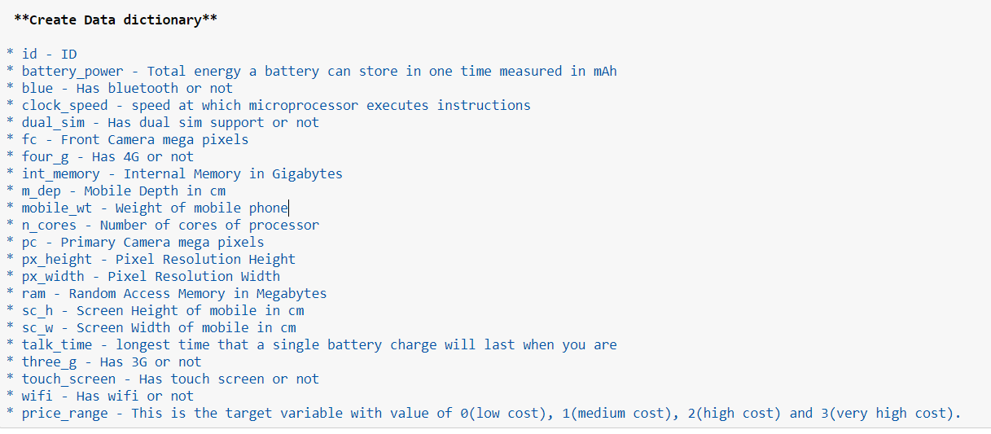
About Dataset
This dataset contain information about many mobiles and a variables about it.
Columns:

Slide 5
Data Exploration (Exploratory data analysis or EDA)
The goal is here to find out more about the data.
What question(s) are we trying to solve?
What kind of data we have and how do we treat different types
What's missing from the data and how we deal with it.
How can we add, remove and change features to get more out of the data

Slide 6
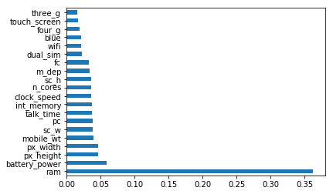
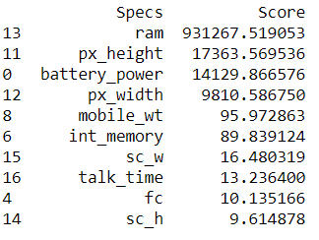
Feature Extraction
Feature importance gives you a score for each feature of your data, the higher the score more important or relevant is the feature towards your output variable.
Ex: Ram, Battery_power, px_height, px_width, mobile_wt, etc.

Slide 7
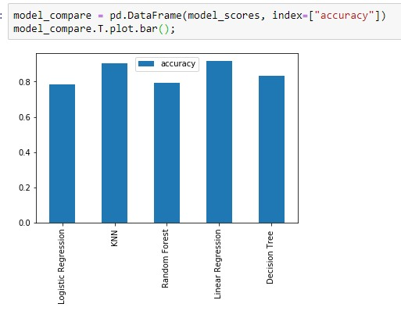
Model Comparison (Before Feature Extraction)
Result
Logistic Regression : 0.7825
KNN : 0.905
Random Forest : 0.7925
Linear Regression: 0.9174
Decision Tree : 0.83250

Slide 8
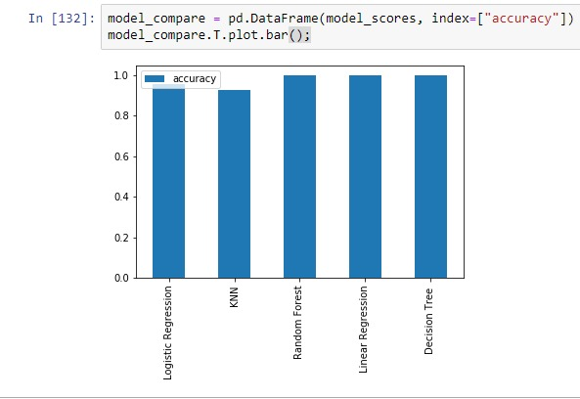
Model Comparison (After Feature Extraction)
Result
Logistic Regression : 0.955
KNN : 0.9275
Random Forest : 1.0
Linear Regression: 1.0
Decision Tree : 1.0

Slide 9
Result Analysis
Model Name | Before FE | After FE
Logistic Regression | 0.7825 | 0.955
KNN | 0.905 | 0.9275
Random Forest | 0.7925 | 1.0
Linear Regression | 0.9174 | 1.0
Decision Tree | 0.83250 | 1.0

Slide 10
Thank You

